Slide 1
DETECTION OF HUMAN PRESENCE
Don’t let your online presence be greater than your real life presence

Slide 2
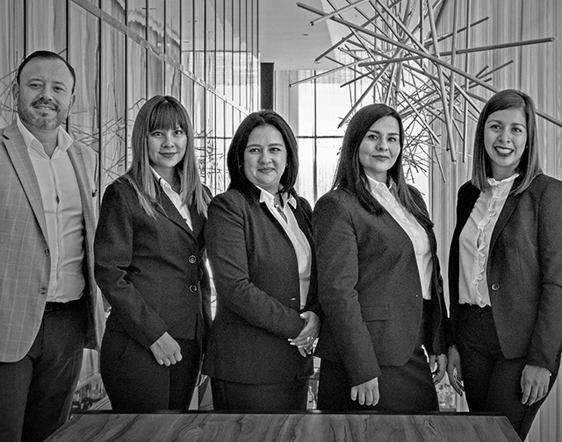
ABOUT US
Our project aims to track the number of people present at a place using python & openCV library which uses optical flow tracker to track the person when one enters/leaves the room.

Slide 3

PROBLEM
Over the recent years, detecting human beings in a video scene of a surveillance system is attracting more attention due to its wide range of applications in abnormal event detection, human gait characterization, person counting in a dense crowd, person identification, gender classification, etc.
Our project aims to track the number of people present at a place and can be used in stores, restaurants, malls, etc. to get data on how many visitors enter a store and at what time. To know how many visitors actually become customers.

Slide 4

SOLUTION
It aims to track the number of people present at a place and can be used in stores, restaurants, malls, etc. to get data on how many visitors enter a store and at what time. To know how many visitors actually become customers.
- Reduces cost of operation as it is autonomous, so human error and costs are eliminated.
- It helps implement COVID-19 norms at public places by preventing overcrowding , by keeping a count of people present there at a given time.
- It is financially viable as it only needs a camera and a computer.
- Helps businesses better understand customer patterns and target sales accordingly.

Slide 5
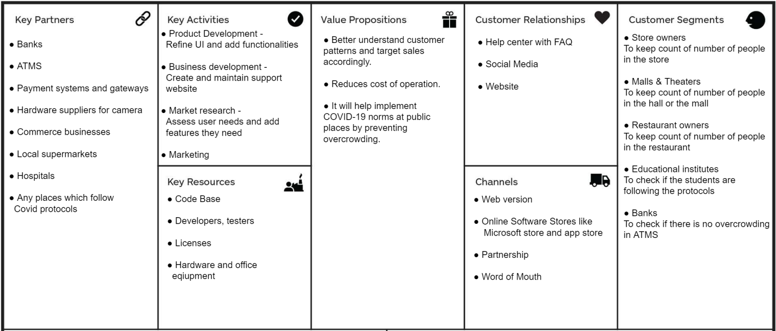
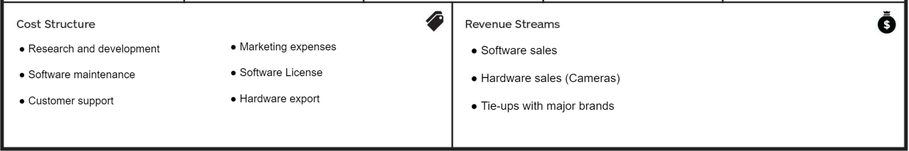
BUSINESS MODEL
1
2
3

Slide 6
MARKET OPPORTUNITY
● Banks and ATMs - Banks can track the number of people in the Bank at any time and it can help the bank to limit the number of people in the bank to avoid overcrowding of the counters.
● Examination - Schools and colleges can use our software by asking students to install it and run it during their exams to ensure that they do not leave the exam room.
● Hardware suppliers for camera - Manufacturing of modified cameras with preinstalled software for third party buyers
● Commerce businesses - Will help the shopkeeper to track the number of customers in the shop to avoid overcrowding.
● Government – The government can use it implement Covid protocol and SOPS; it will also help to control crowds and large public gatherings.

Slide 7
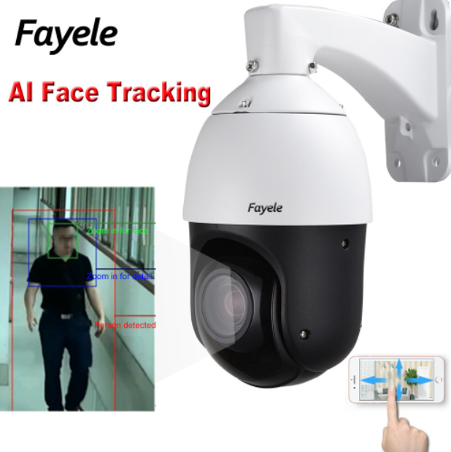
COMPETITION
Conventional Human Detection:
•Manual detection were done by the humans themselves in order to keep track of crowds.
•Takes an enormous amount of time.
•For surveying and supervising, humans were needed as well.
• In 1997 CAPTCHA was invented to make sure that a human was operating the system not a bot, it was the first human detection system.
•Some companies providing human detection are as follows:-
•A)MicroSearch
•B)Open Facetracker
•C)OpenBR

Slide 8
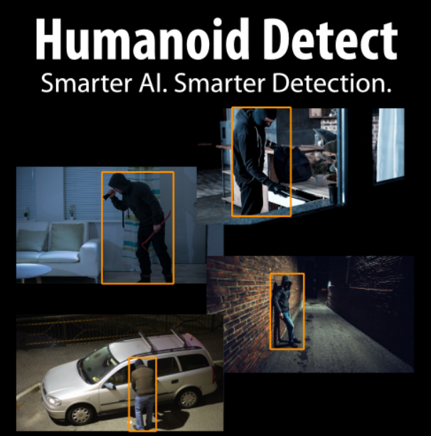
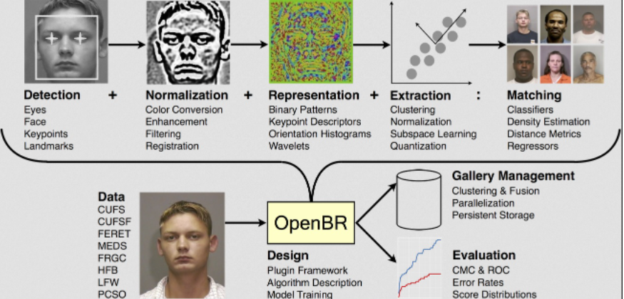
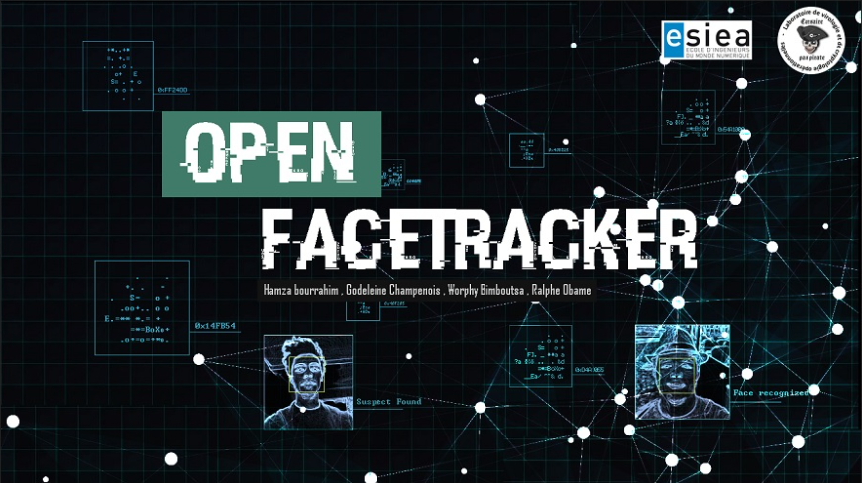

COMPETITION PART 2
More Convenient
More Expensive
Less Convenient

Slide 9
GROWTH STRATEGY
Product development and Market expansion::-
§Constant feedback from customers for continuous development of product to make it more user friendly
§To approach big corporations like Reliance Mart, More and Dmart to partner with them.
2.Market capturing:-
§Once the consumers are aware of the products marketers will approach companies with attractive offers to gain an edge over other competitors
§
§
1.Market penetration
§After Creation of product aggressive marketing will be undertaken to make the consumers aware about the various benefits of the product. This will be done by approaching local supermarkets and local food chains.

Slide 10
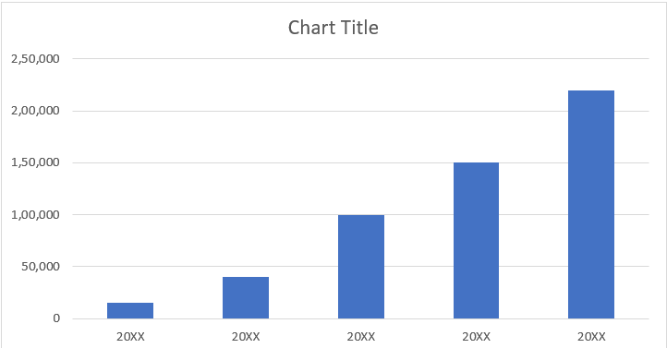
TRACTION
Key Metrics
Revenue by Year
 | Clients | Orders | Gross Revenue | Net Revenue
2022 | 5 | 10 | 15,000 | 6,000
2023 | 10 | 50 | 40,000 | 16,000
2024 | 15 | 200 | 1,00,000 | 65,000
2025 | 20 | 400 | 1,50,000 | 1,10,000
2026 | 25 | 600 | 2,20,000 | 1,60,000

Slide 11
FINANCIALS
 | 2024 | 2025 | 2026
Users | 200 | 400 | 600
Jobs | - | - | -
Average price per job | - | - | -
COMPANY REVENUE @15% | 1,00,000 | 1,50,000 | 2,00,000
- Cost of Revenue | 35,000 | 40,000 | 50,000
Gross Profit | 65,000 | 1,10,000 | 1,50,000
- Sales & Marketing | 10,500 | 30,000 | 50,000
- Customer Service | 10,500 | 15,000 | 30,000
- Product Development | 20,000 | 30,000 | 40,000
- Misc. | 10,250 | 10,000 | 20,000
TOTAL OPEX | 50,100 | 85,000 | 1,60,000
EBIT | +14,900 | +25,000 | 40,000

Slide 12
OUR TEAM
Name | Register Number
MAYANK GOKHALE | RA1911030010057
YUVRAJ SINGH CHAUHAN | RA1911027010058
DARSHIL KETAN SHAH | RA1911028010121
ADITHYA PRATAP SINGH | RA1911031010061

